Slide 1
Molecular Biology Biol 480
Lecture 32 April 17th , 2019

Slide 2
Announcements/Assignments
Let’s make a schedule for presentations:
April 24^{th—}Start at 11:00 am
Dakota
Beverly
Sidni
May 1—Start at 10:00 am
Brody
Dayo
Shyla
Zach

Slide 3
Where were we?...Gene expression regulation in Eukaryotes
The path to active RNA and proteins takes many steps/factors.
Access to DNA where the gene is located
Transcription of the gene
Post transcriptional processing of the RNA transcript
Export from the nucleus
Translation (if protein encoding gene)
Posttranslational modifications
All steps are themselves points of regulation of gene expression

Slide 4
What have we seen?
Increasing access to gene regulatory regions---MyoD can lead to chromatin remodeling (opening) of regulatory regions in muscle-specific genes.
Transcription activation—several examples
Sequence-specific mRNA destruction –RNAi, miRNA

Slide 5
Stepping back to mRNA—mRNA turnover
Transcription regulation only makes sense if we assume that mRNA , once made, eventually decays, breaks down or is actively degraded.
Otherwise mRNA would only have to be made once and would continually be translated into protein.
Prokaryotes primarily use transcription regulation for gene regulation. Therefore, prokaryotic mRNA is generally unstable. It has a high rate of turnover—if some protein is called for, generally more mRNA must be transcribed.

Slide 6
Both prokaryotic and eukaryotic mRNA have features that leave them susceptible to degradation by RNAses. (All linear nucleic acid is a target for exonucleases)
However---Both 5’ and 3’ modifications of eukaryotic mRNA add stability to the mRNA.
Even so…Eukaryotes actually have at least 3 pathways for active degradation of mRNA.

Slide 7
RNAs have a characteristic life-span called its half-life( t_{1/2})
Different RNAs can vary considerably in t_{1/2} from minutes to hours or months.
Some mRNA in oocytes is stable for years.
**The longer the mRNA lasts the more protein can be potentially made.

Slide 8
Eukaryotic mRNA may be degraded in basically 3 ways:
1. Loss of polyA tail. When eukaryotes add the polyA tail, it consists of ~200 nucleotides. In its normal length, it binds to a protein called polyA binding protein. This protein likely stabilizes and protects the mRNA. But when the poly A tail is less than ~30 nucleotides, it loses the ability to bind the protein and becomes a target for endonucleases.

Slide 9
De-capping—removal fo the 7-meG cap. This also makes the mRNA a target for digestion by RNases from the 5’ end.
Cleavage internally by RNA endonucleases. Likewise, creating smaller RNA fragments, induces digestion by exonucleases.

Slide 10
Certain sequences in the mRNA (5’ and 3’ UTRs) determine stability, and cytoplasmic destination.
Certain sequences even target rapid destruction of mRNA. These so-called instability sequences insure that the encoded protein is not made in excess. Repeated AUUUA in mRNA makes it unstable. (This sequence is known as an adenosine-uracil rich element or ARE.)

Slide 11
Translation itself, also affects mRNA stability.
For example, in the translation of α and β tubulin mRNA (which encodes the protein needed to make microtubules), the first few amino acids, interact with fully translated and folded tubulin proteins.
When the tubulin proteins are abundant, it leads to the destruction of mRNA encoding the proteins.

Slide 12
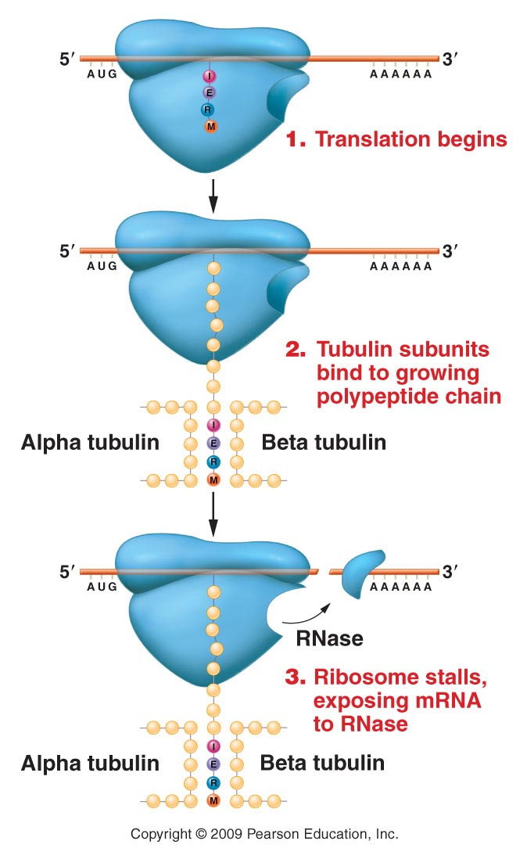
Figure 18.21
Notes:
Figure 18-21 Model showing how tubulin subunits may control the stability of tubulin mRNA.

Slide 13
Translation regulated mRNA stability
Although fewer genes are regulated at the level of translation, there are reasons to for some mRNAs to be made constitutively, and made ready for translation “at a moments notice”. Explain?

Slide 14
Example?
Iron-metabolism proteins:
Ferritin---an iron storage protein. In times of excess iron, ferritin is needed to hold on to iron until needed and to prevent toxicity in the cell.
Transferrin receptor---a cell surface receptor needed to bring iron into the cells. In times of low iron, cells need to be ready to transfer in more iron from outside the cell.

Slide 15
Both transferrin receptor mRNA and ferritin mRNA are made constitutively in liver cells. (The genes that encode these mRNAs could be considered housekeeping genes---for hepatic cells).
Both mRNAs contain sequences called iron responsive elements (IREs)
http://en.wikipedia.org/wiki/Iron_response_element

Slide 16
IREs form stem loops

Slide 17
An IRE is located in the 5’UTR of the ferritin mRNA
An IRE is located in the 3’UTR of transferrin receptor mRNA.
IREs bind proteins called Iron responsive proteins (IRPs)

Slide 18
IRE-IRP interaction can result in different outcomes.
The interaction can block translation of the mRNA in some cases.
The interaction can stabilize the mRNA in other cases.

Slide 19
Cool system!

Slide 20
Other control points for gene expression. What happens to eukaryotic mRNA after transcription? Usually splicing!
Recall, anything that inhibits or speeds splicing will affect rate of production of an active protein.
Alternative splicing is a great example of how splicing can significantly change what type of protein is translated.

Slide 21
Your book uses a great example of the calcitonin gene mRNA that gets sliced alternatively in 2 cell types. The protein(s) produced regulate different things in different cell types.
STUDY figure 17-11!

Slide 22
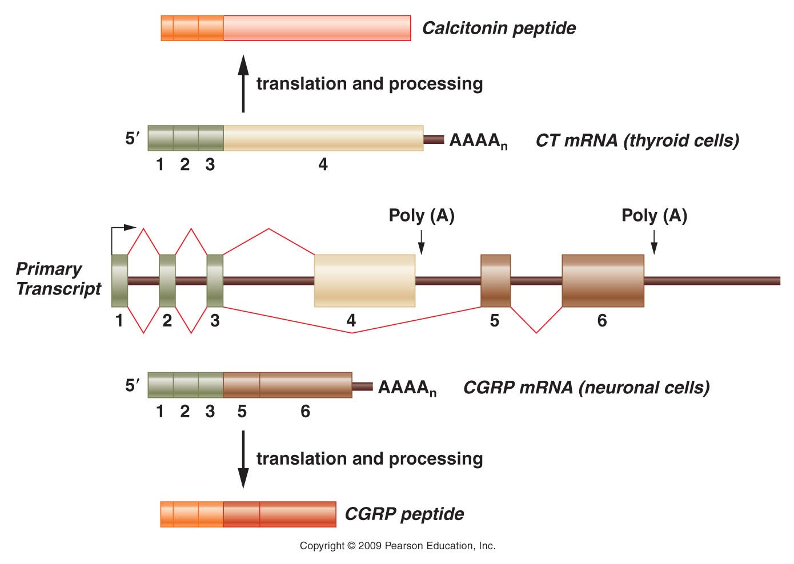
Figure 18.18
Notes:
Figure 18-18 Alternative splicing of the CT/CGRP gene transcript. The primary transcript, which is shown in the middle of the diagram, contains six exons. The primary transcript can be spliced into two different mRNAs, both containing the first three exons but differing in their final exons. The CT mRNA contains exon 4, with polyadenylation occurring at the end of the fourth exon. The CGRP mRNA contains exons 5 and 6, and polyadenylation occurs at the end of exon 6. The CT mRNA is produced in thyroid cells. After translation, the resulting protein is processed into the calcitonin peptide. In contrast, the CGRP mRNA is produced in neuronal cells, and after translation, its protein product is processed into the CGRP peptide.

Slide 23
Recall…alternative splicing is thought to be one mechanism to explain the relatively low number of genes (25,000) found when the human genome was sequenced…
Those 25K genes likely ecode .5-2 million proteins.
The proteins made in a specific cell is known as its proteome.

Slide 24
One of the most extreme cases of alternative splicing is observed in a gene in the fruit fly---Drosophila melanogaster.
A gene called Dscam encodes (a) protein needed for neuron connections.

Slide 25
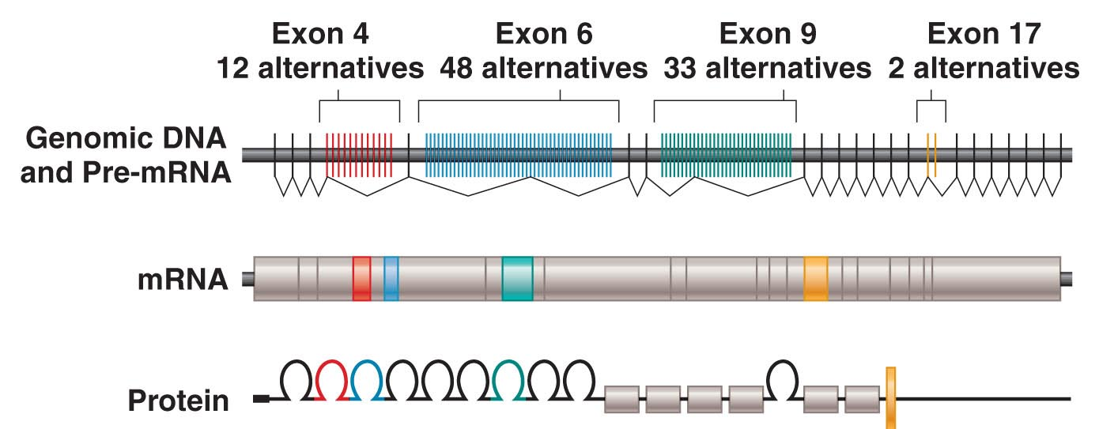
Figure 18.19
Notes:
Figure 18-19 Alterntive splicing of the Dscam gene mRNA. (Top) Organization of the Dscam gene in Drosophila melanogaster and the transcribed pre-mRNA. Each mRNA will contain one of the 12 possible exons for exon 4 (red), one of the 48 possible exons for exon 6 (blue), one of 33 for exon 9 (green), and one of 2 for exon 17 (yellow). If all possible combinations of these exons are used, the Dscam gene can encode 38,016 different versions of the DSCAM protein.

Slide 26
The entire Drosophila genome encodes ~13,000 proteins.
Alternative splicing allows Drosophila to make over 38,000 forms (isoforms) of the Dscam protein!

Slide 27
Drosophila sex is determined by alternative splicing
You may have learned that Drosophila sex works like mammals—XX=female and XY=male
Actually sex is the result of a specific ratio of X-chromosomes to autosomes.
1X: 2 sets of autosomes leads to male development (even with no Y chromosome )
2X: 2 sets of autosomes leads to female development.

Slide 28
3 genes are responsible for sex development
sxl
tra
dsx
When ratio X:A=1, sxl is transcribed and translated. This female-specific protein regulates female-specific splicing of the tra mRNA, which in turn regulates female-specific splicing of the dsx mRNA.

Slide 29
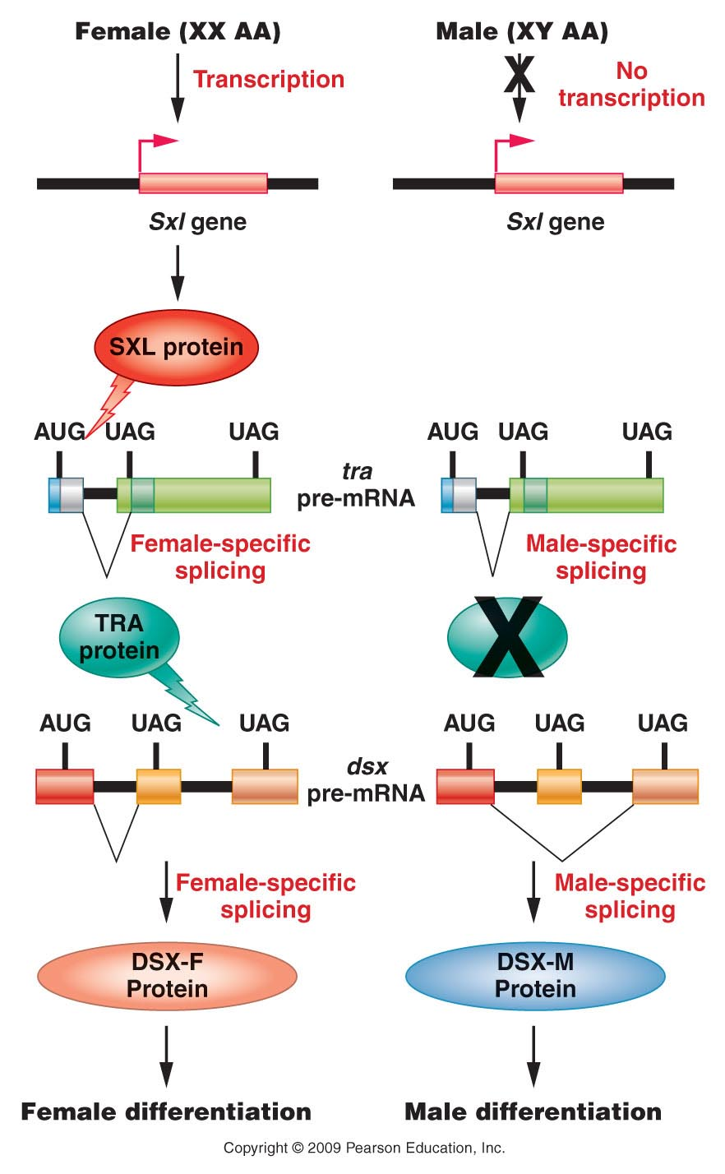
Figure 18.20
Notes:
Figure 18-20 Regulation of pre-mRNA splicing that determines male and female sexual development in Drosophila. The ratio of X chromosomes to autosomes affects transcription of the Sxl gene. The presence of SXL protein begins a cascade of pre-mRNA splicing events that culminate in female-specific gene expression and production of the DSX-F transcription factor. In the absence of SXL protein, a male-specific pattern of pre-mRNA splicing results in male-specific patterns of gene expression induced by the DSX-M protein.

Slide 31
Just to clarify---not all genes engage in any form of alternative splicing---but when some do, it can greatly increase the genome’s potential for protein variations.

Slide 32
Translation regulation
For next time!
Review Translation mechanism figures---note/recall that translation initiation requires initiation factors (IF proteins).
It is not enough to have transcribed mRNA, ribosomes, and charged tRNAs---translation itself is regulated buy protein factors.

